Slide 1
Graphical User Interfaces
A Quick Outlook

Slide 2
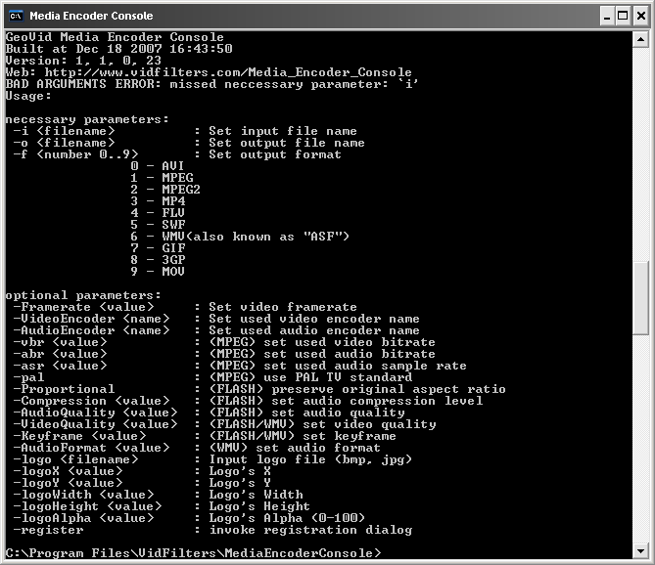
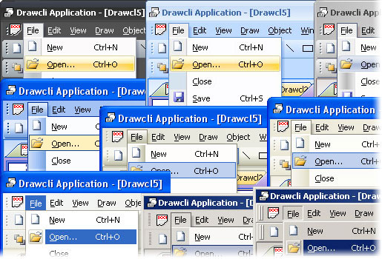
Interface
Many methods to create and “interface” with the user
2 most common interface methods:
Console
GUI

Slide 3
Interface Alternatives: Console
Command line Interface
Easier to use for certain operations/scenarios
You enter input using either given as parameters during the startup or by some menus/options inside the application

Slide 4
Interface Alternatives : Console
#runapp.exe param1 param2
>Hello User
#Hello Console
>Give me input:
#`input`
>Give more
#`more input`
>More
#`even more input`
>I SAID MORE INPUT
#`Most input you can provide`
>Press “return” to start computing your input
>Wait for my answer “User”
#waiting …
#waiting …
>Your answer is : 3
>Bye “user”

Slide 5
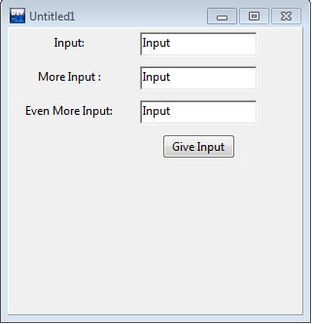
GUI

Slide 6
GUI
Textbox 1
Textbox 2
Textbox 3
Submit Button

Slide 7
GUI
Easier to use
Supply input with keyboard and deliver with mouse
Less text to explain what to do on screen

Slide 8
Common GUI Tasks
Titles / Text
Names
Prompts
User instructions
Fields / Dialog boxes
Input
Output
Buttons
Let the user initiate actions
Let the user select among a set of alternatives
e.g. yes/no, blue/green/red, etc.

Slide 9
Common GUI tasks (cont.)
Display results
Shapes
Text and numbers
Make a window
Style and color
More advanced
Tracking the mouse
Dragging and dropping
Free-hand drawing

Slide 10
GUI
From a programming point of view GUI is based on two techniques
Object-oriented programming
For organizing program parts with common interfaces and common actions
Events
For connecting an event (like a mouse click) with a program action

Slide 11
Object Oriented Programming and GUI
Every button, text, label etc. is a class instance
Actions are member functions
Can create own class derivations and reuse them :

Slide 12
Events and GUI
As mentioned earlier GUI programming is event based
Clicking a button, entering text, keyboard press, mouse movement …
Bind events to member functions => interactive GUI

Slide 13
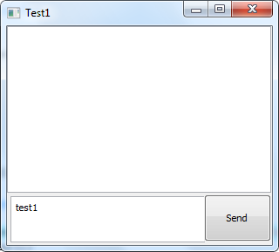
GUI
Enter text to textbox

Slide 14
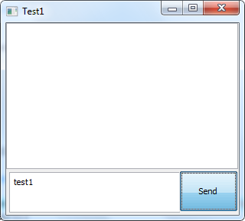
GUI
Press the send button and fire the “click” event

Slide 15
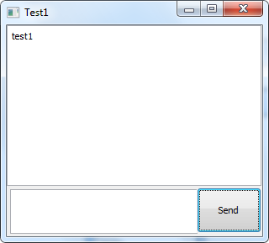
GUI
The data in the textbox is read.
Then added to the textbox above.
Finally the event finishes by clearing the input box

Slide 16
What? How?
We saw buttons, input boxes and an outbox in a window
How do we create a window?
How do we create buttons?
How do we create input and output textboxes?
Click on a button and something happens
How do we program that action?
How do we connect our code to the button?
You type something into a input box
How do we get that value into our code?
How do we clear the input of the box ?
We saw output in the output box
How do we get the values there?
Will see in the labs this week!

Slide 17
Console ⬄ GUI Mapping
For each console query create new label/textbox pairs
Don’t try to take all inputs from a single textbox
After all user “queries” are filled in create a single button to submit the data

Slide 18
References
Based on Slides : Graphical User Interfaces by Bjarne Stroustrup www.stroustrup.com/Programming

